Slide 1

Flow Network in Supply Chain & Logistics
Modelling I - MP305
Dhruv Rastogi
Prachi Tiwari
Utkarsh Gupta

Slide 2

Supply Chain & Logistics
Supply Chain: The complex network of organisations, processes, and resources involved in delivering products or services from suppliers to consumers.
Logistics: The strategic management of the movement, storage, and distribution of goods, services, and information throughout the supply chain.
Notes:
Dhruv
Talk about supply chain and logistics

Slide 3
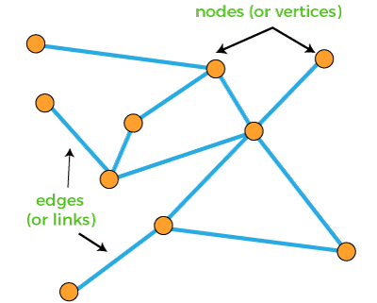
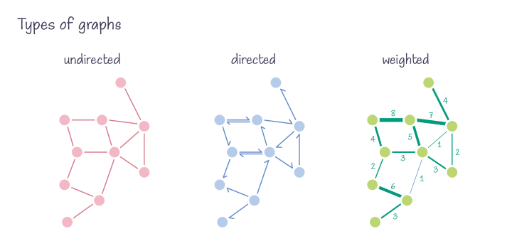
Role of Graph Theory
Solving complex optimisation problems in supply chain management, including network design, transportation optimisation, and routing
Degree = 5
Notes:
Dhruv

Slide 4
Challenges in Implementing Graph Theory in Supply Chain and Logistics
Complex Real-world Networks
Dynamic Environments
Real supply chain networks can be highly complex, making accurate modelling a challenge.
Supply chains are dynamic, and optimising for changing conditions adds complexity.
Notes:
Dhruv

Slide 5
Future Trends and Technologies in Supply Chain Optimization
Blockchain Technology
Machine Learning
Offers secure, transparent, and traceable supply chain transactions, reducing fraud and enhancing trust.
ML can provide insights and recommendations for improved route optimization and demand forecasting.
Notes:
Dhruv

Slide 6
Supply Chain and Logistics Network Representation
Supply chains and logistics networks are efficiently represented as graphs with nodes and edges.
Nodes - These represent locations (e.g. Suppliers, Warehouses, Stores/Retailers)
Edges - They connect nodes to represent transportation routes
Attributes - Attributes can be added to both nodes and edges to represent various factors associated with supply chain and logistics operations. Example, cost, capacity, lead time, quality or service level.
Notes:
Prachi

Slide 7
Supply Chain Optimisation
Transportation Optimisation
Shortest Path Algorithms: We can use algorithms like Dijkstra's or Floyd-Warshall to find the shortest and most cost-effective transportation routes.
Flow optimisation: We can use algorithms like Ford-Fulkerson algorithm or the maximum flow-minimum cut theorem to optimize the flow of goods between nodes, ensuring that demand is met efficiently.
Inventory Management
Safety Stock Calculation: We can use graph-based models to calculate safety stock levels at different nodes based on demand changes, lead times, and service level requirements.
Notes:
Prachi

Slide 8
Benefits of Graph Theory
It helps find the most efficient transportation routes, minimizing transportation costs and maximizing the use of available resources
It helps to understand the complicated dependency and relationship between suppliers, warehouses, customers and transportation routes.
Based on lead time, cost, and quality parameters, graphs help choose the best suppliers and ideal sites for warehouses or distribution centres.
Notes:
Prachi

Slide 9
Use of Network Flow in inventory management
Ways in which Network flow model can be used for inventory management includes
Inventory Optimization
Representing Stock Levels as Attributes on Nodes
Analyzing Inventory Costs and Holding Costs
Calculating Reorder Points and Order Quantities
Notes:
Utkarsh

Slide 10
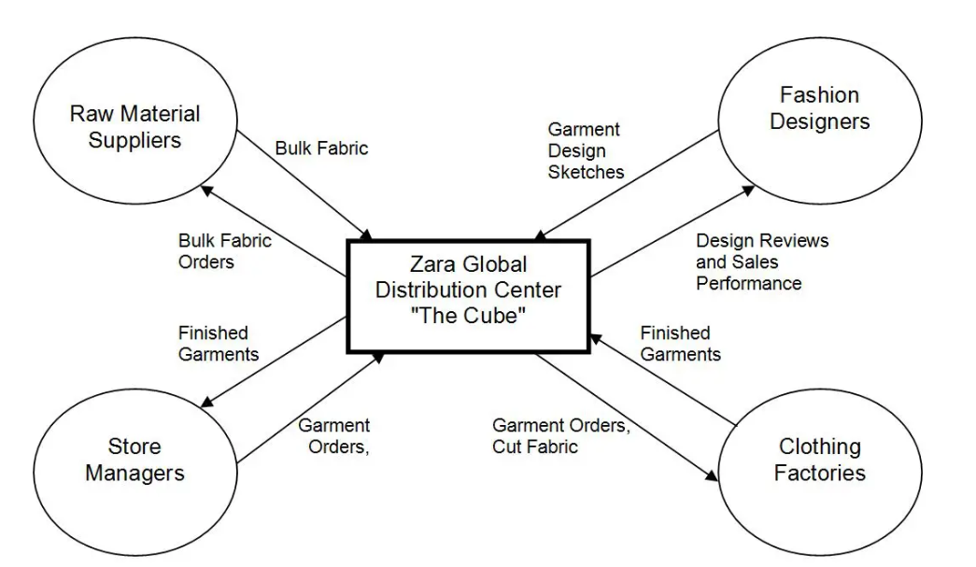
Case Study- Zara
Notes:
Utkarsh

Slide 11
Conclusion
Graph Theory plays a pivotal role in Supply Chain and Logistics Optimization-
provides a structured framework to model, analyze, and enhance the efficiency of complex supply chain networks
enables organizations to visualize the flow of goods, information, and resources across various nodes and edges
Max Flow-Min Cut algorithm, aids in finding the most efficient paths, minimizing costs, and ensuring timely delivery of products
empowers businesses to adapt to changing market demands
Notes:
Utkarsh

Slide 12
THANK YOU!

